Slide 1
TLC quantum PROGRESS Meeting
Fontys

Slide 2
Agenda
Recap
Goals Sprint 4
Finished Goals
Demo
Sprint 5 goals

Slide 3
Recap goals
Sprint Goals Planned
Documentation:
U-N016: Data and Law (GDPR)
U-N018: User Friendly Research
Website:
U-E034: Start Game
U-E023: View Leaderboard
U-E037: Challenge User
U-E038: Accept Challenge
U-N019: Deploy

Slide 4
Recap goals
Sprint Goals Done
Documentation:
U-N016: Data and Law (GDPR)
U-N018: User Friendly Research
Website :
U-E034: Start Game
U-E023: View Leaderboard
U-E037: Challenge User
U-E038: Accept Challenge
U-N019: Deploy

Slide 5
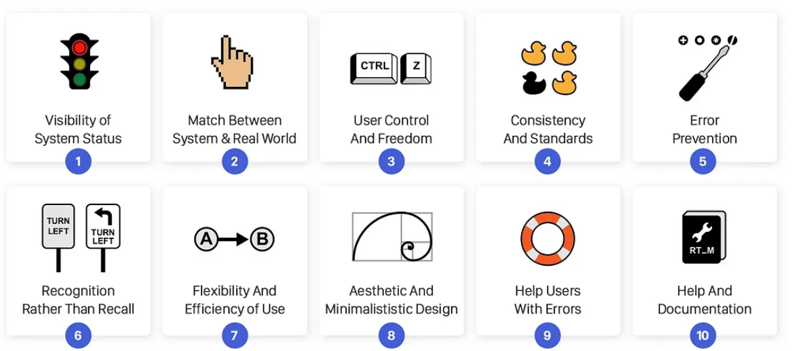
User Friendly Research
Principles

Slide 6
Data and Law
General Data Protection Law (GDPR)
Handling data with care
Securely storing sensitive data
Limiting data

Slide 7
Demo

Slide 8
Goals for sprint 5
Next Sprint Goals
Website:
U-N021: Full integration
Next Progress Meeting: June 20th

Slide 9
Goals for sprint 5
Next Sprint Goals
Documentation
U-N020: Hand-Over Document
Next Progress Meeting: June 20th

Slide 10
Thank You

